Slide 1

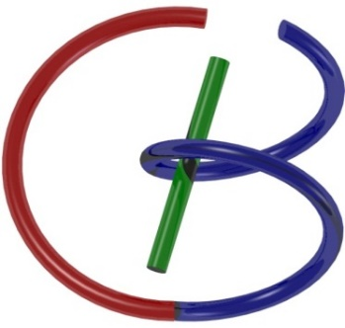
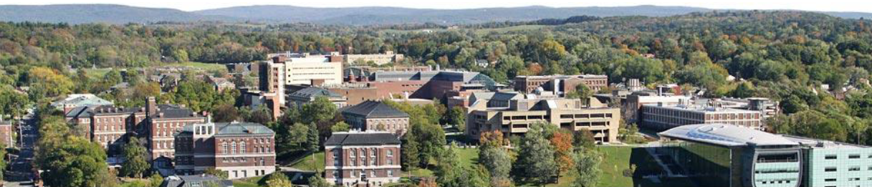
Diagnostic Performance: Good to Use?
Ge Wang
AI-based X-ray Imaging System (AXIS) Lab
Rensselaer Polytechnic Institute, Troy, New York, USA
November 30, 2021

Slide 2
MI Schedule for F21
Tue | Topic | Fri | Topic
08/31 | Introduction | 09/03 | Neuron, Network & Backpropagation
09/07 | No Class | 09/10 | Hands-on 1: Python, Colab, & TensorF
09/14 | Architectures & Training | 09/19 | Hands-on 2: MNIST Classification
09/21 | Image Quality | 09/24 | CT Physics
09/28 | CT Reconstruction | 10/01 | Deep CT Reconstruction
10/05 | Hands-on 3: CT Networks | 10/08 | More CT Contents
10/12 | MRI Physics | 10/15 | Spin-Echo
10/19 | K-Space Theorem | 10/22 | More MRI Contents
10/26 | Mid Exam | 10/29 | Deep MRI Reconstruction
11/02 | Hands-on 4: MRI Networks | 11/05 | Nuclear Physics
11/09 | Nuclear Imaging | 11/12 | US Imaging
11/16 | Optical Imaging | 11/19 | Multimodality Imaging
11/23 | Hands-on 5: Image Conversion | 11/26 | Thanksgiving
11/30 | Diagnostic Performance | 12/03 | Closing Remarks
12/07 | Overview | 12/10 | Final Exam
Office Hour: Teaching Day 5-6pm: https://rensselaer.webex.com/meet/wangg6

Slide 3
Outline
Momentum of Deep Imaging / AI in Medicine
AI Software as Devices & FDA Approval
Traditional Metrics
GRACE Challenges
Generalizability
Robustness
Autonomy
Certifiability
Explainability

Slide 4
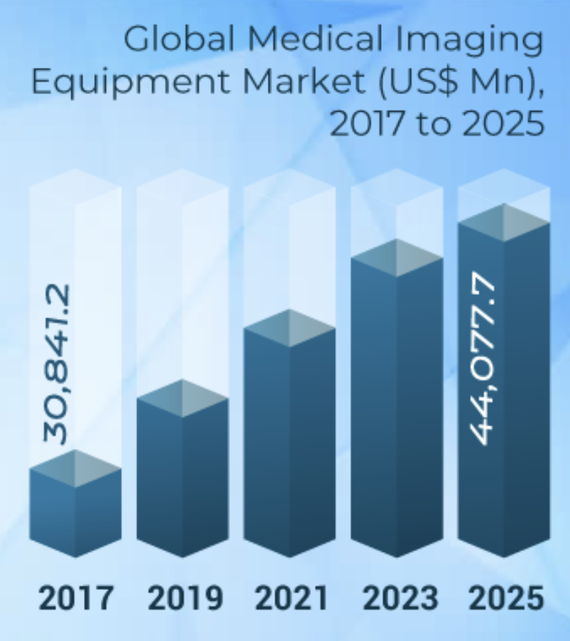
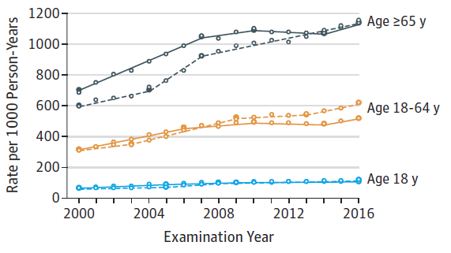
Importance of Medical Imaging
Number of Imaging Exams per 1,000 Person-Years in USA
Smith-Bindman R, et al: JAMA 322(9):843-856, doi:10.1001/jama.2019.11456, 2019 https://www.medgadget.com/

Slide 5
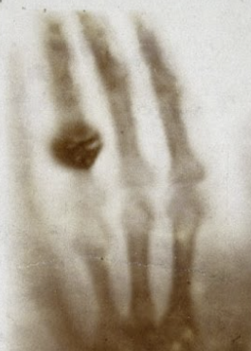
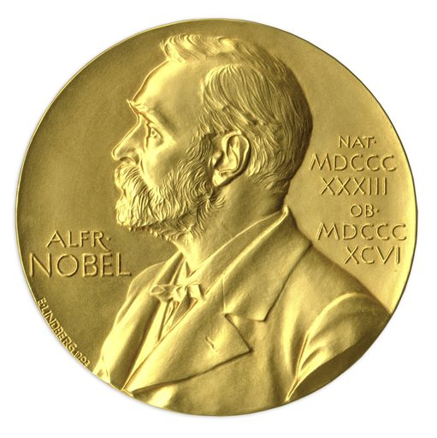
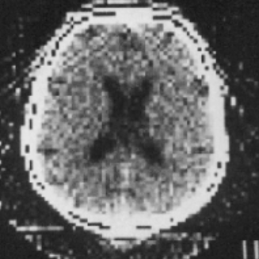
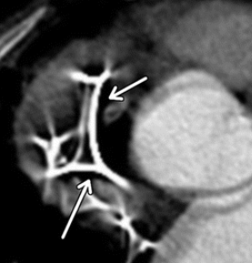
Challenges in Medical Imaging
Shaper Resolution
Better Signal-to-Noise Ratio
Faster Speed
Richer Information
Higher Sensitivity & Specificity
Lower Radiation & Contrast Agent Dose
Less Image Artifacts
Cheaper Imaging Cost
More flexibility
…
Cardiac CT Image Metallic Artifacts from Pacemaker Leads

Slide 6
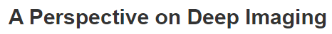

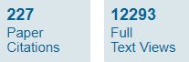
Roadmap for Deep Imaging (2016)
Data
Acquisition
Image
Reconstruction
Featured
Actions
Therapeutics
Features
Radiomics
Wang G, Perspective on deep imaging. IEEE Access, DOI:10.1109/ACCESS.2016.2624938, 2016

Slide 7
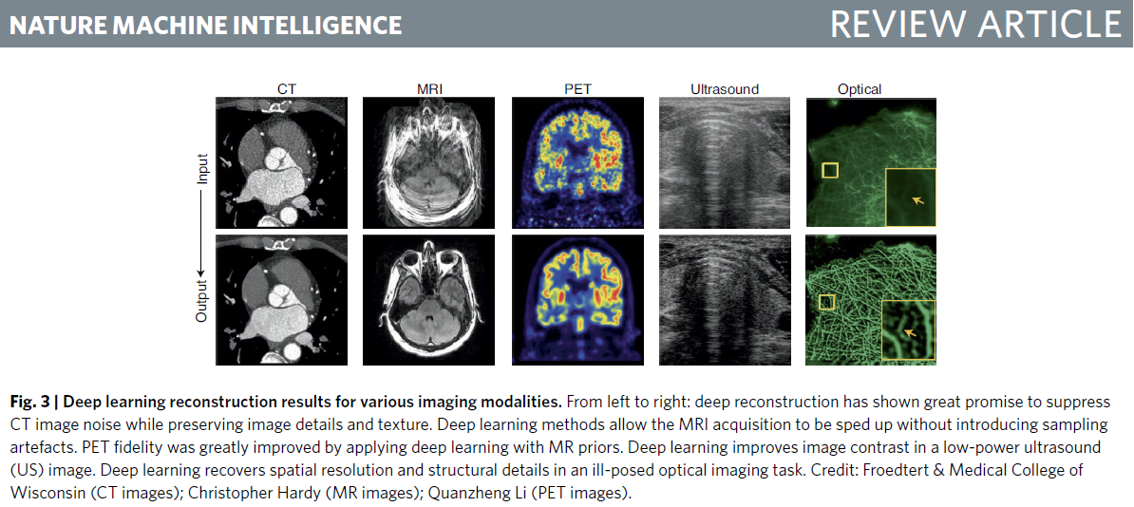
Review on Deep Tomographic Imaging (2020)
Wang G, Ye JC, De Man B: Deep learning for tomographic image reconstruction. Nature Machine Intelligence, DOI: 10.1038/s42256-020-00273-z, 2020

Slide 8

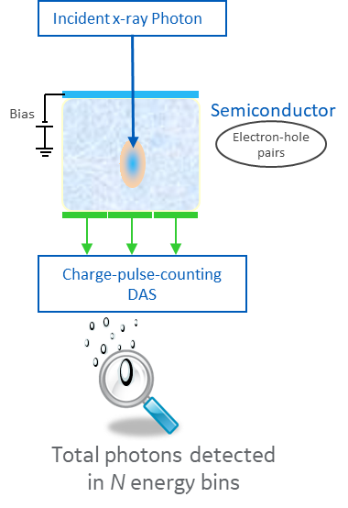
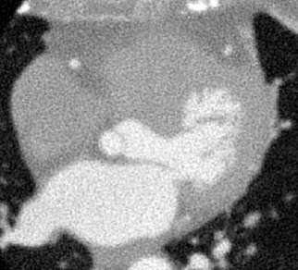
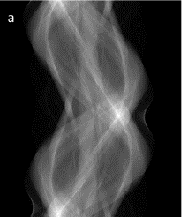
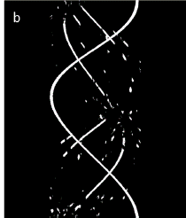




RPI-GRC Collaborations in CT
SETUP & SCAN
IMAGE GENERATION
INTERPRETATION
PATIENT INFO
READING
ECG
CONTRAST
SCOUT
SCAN
SCAN SETUP
SCAN
CALS & CORREC-TIONS
RECON
POST-PROCES-SING
IMAGE ANALYSIS
GENERATE REPORT
Ultra-low-dose screening
Photon-counting CT
MAR for radiation therapy planning
Cardiac CT
Super-resolution
Denoising
Direct sinogram
analysis
Radiomics &
Rawdiomics
PROPOSAL
PAST PROJECT +
NEW PROPOSAL
ACTIVE
PAST
ACTIVE
ACTIVE
ACTIVE

Slide 9
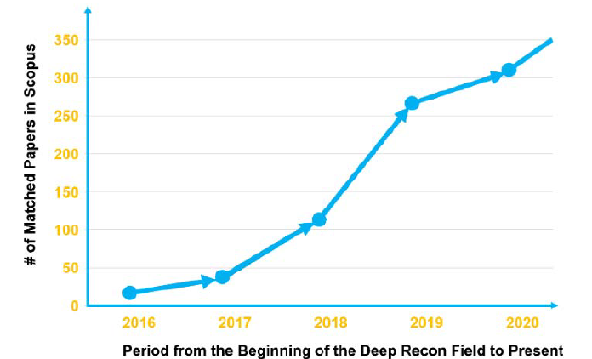
TAC:(“Deep learning” AND “Medical” AND “Image” AND “Reconstruct*”)
Deep Recon Papers in Scopus

Slide 10
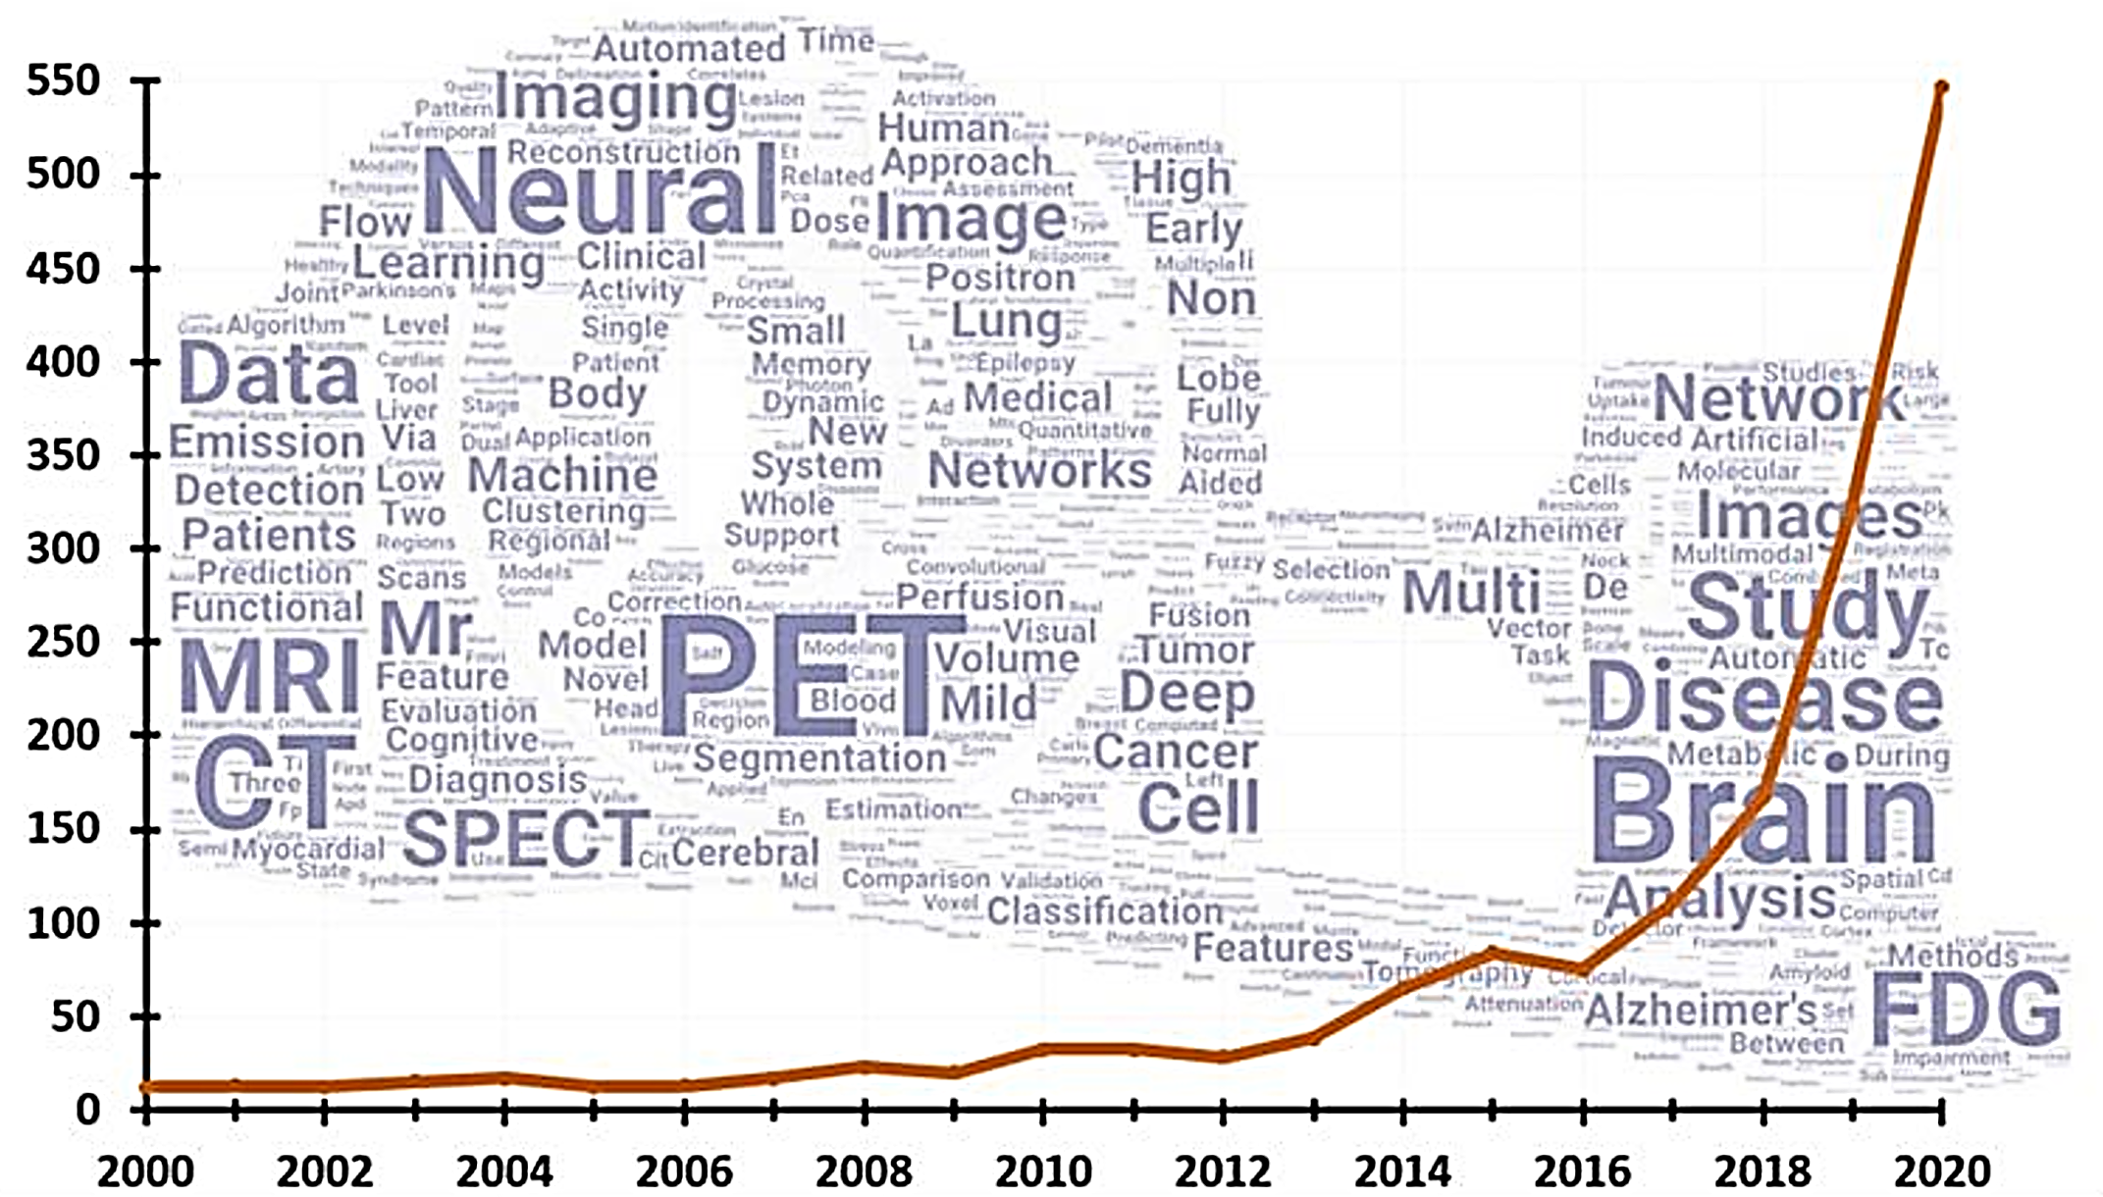
Sven Zuehlsdorff, Siemens Healthineers

Slide 11
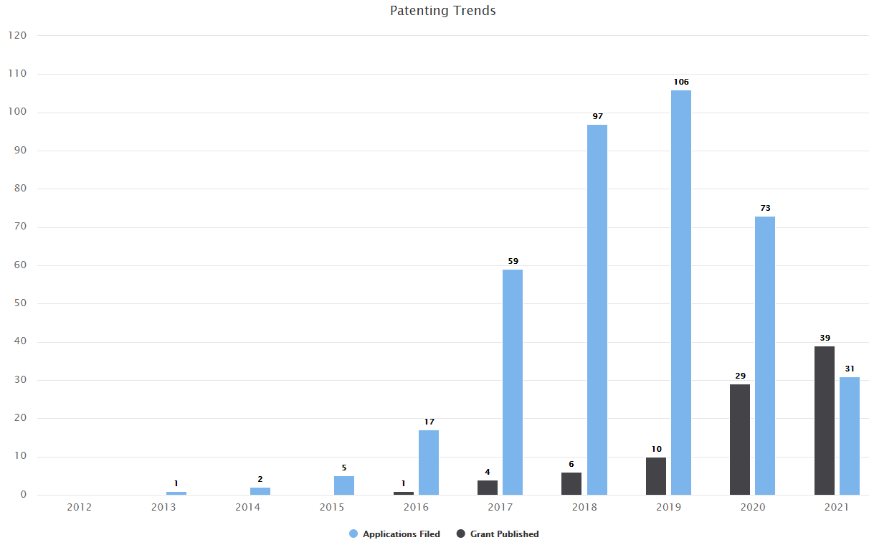
TAC:((“Deep learning" OR “Artificial intelligence" OR AI OR “Machine learning") AND (Tomographic OR Tomography) AND Reconstruction)
AI Imaging Patents in PatSeer

Slide 12
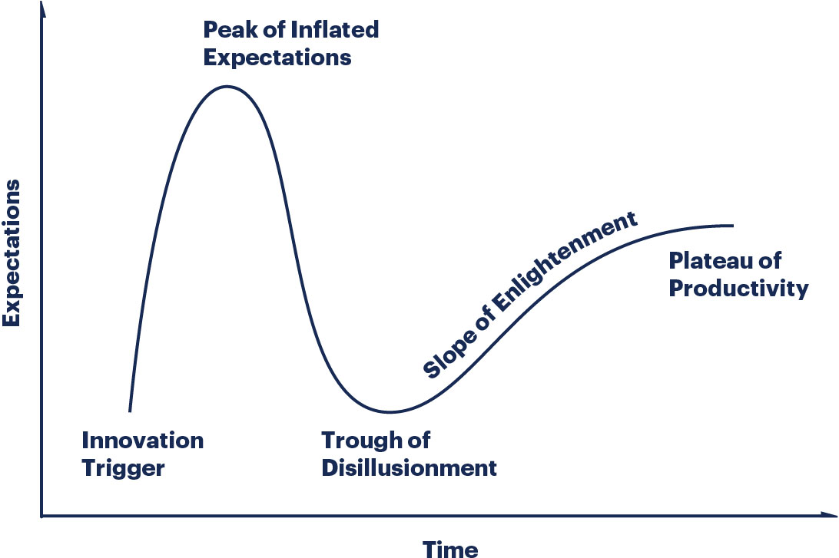
Where Are We on Gartner Curve?

Slide 13
Outline
Momentum of Deep Imaging / AI in Medicine
AI Software as Devices & FDA Approval
Traditional Metrics
GRACE Challenges
Generalizability
Robustness
Autonomy
Certifiability
Explainability

Slide 14
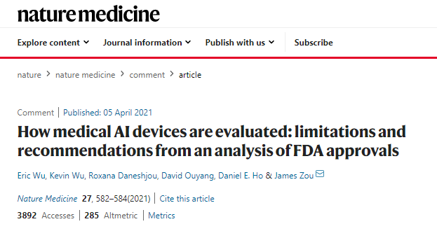
FDA-approved Medical AI Devices
FDA approved 130+ medical AI devices,
~50% over last year

Slide 15
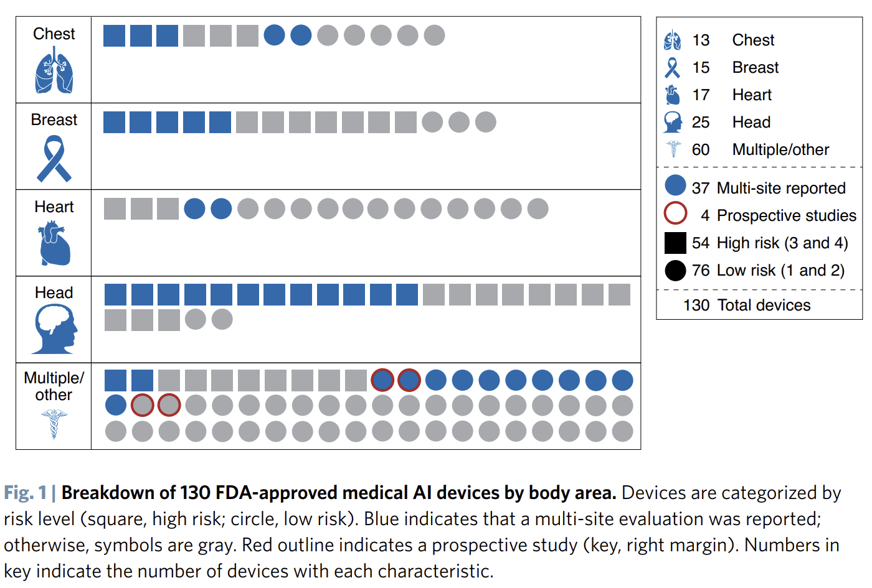

Slide 16
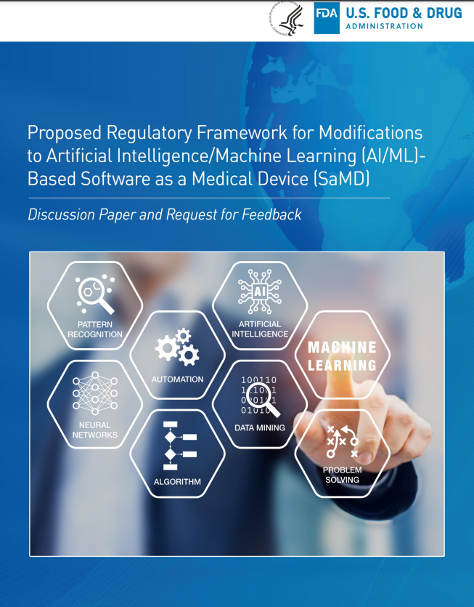
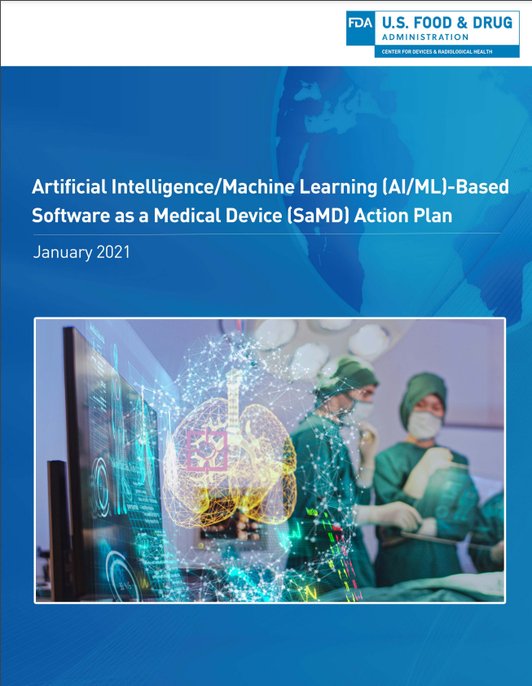
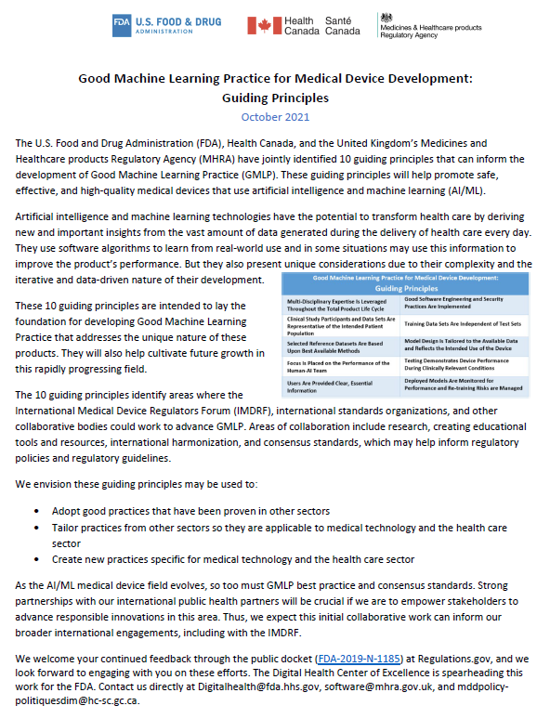
https://www.fda.gov/files/medical%20devices/published/US-FDA-Artificial-Intelligence-and-Machine-Learning-Discussion-Paper.pdf
https://www.fda.gov/media/145022/download
https://www.fda.gov/medical-devices/software-medical-device-samd/good-machine-learning-practice-medical-device-development-guiding-principles

Slide 17
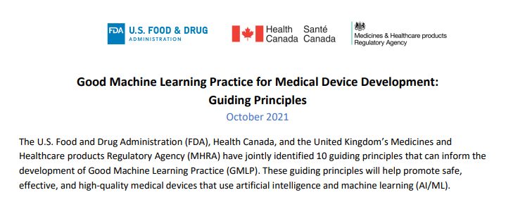
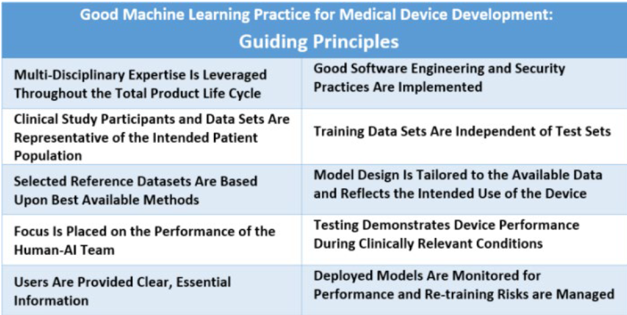
https://www.fda.gov/medical-devices/software-medical-device-samd/good-machine-learning-practice-medical-device-development-guiding-principles

Slide 18
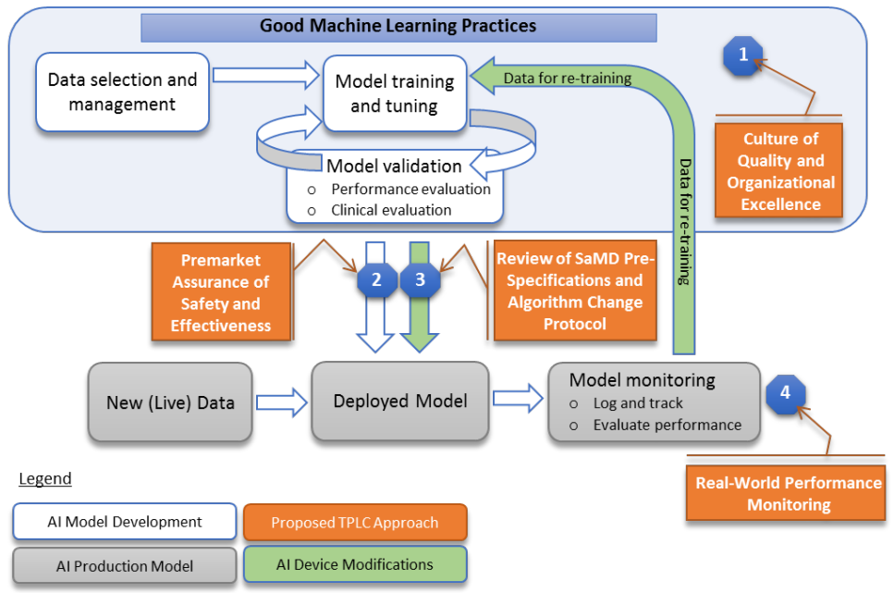
FDA’s Total Product Life Cycle in the AI/ML Workflow

Slide 19
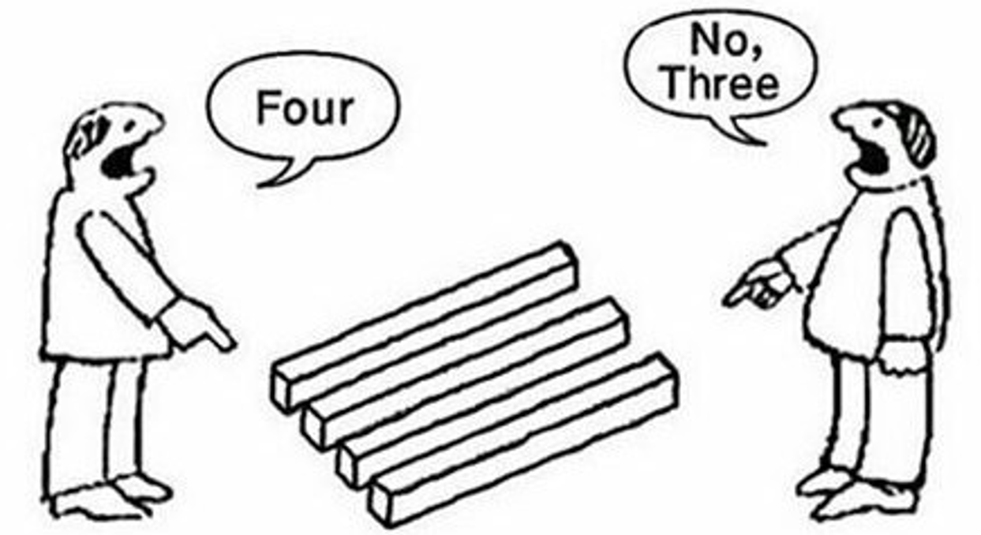
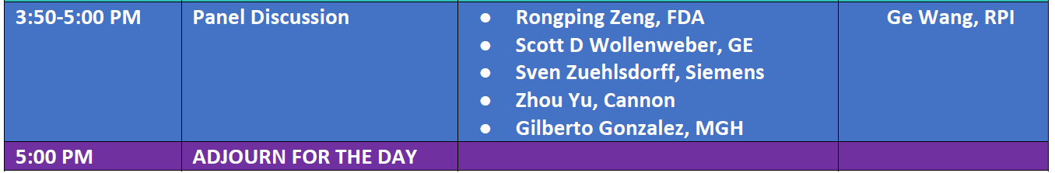

Slide 20
Outline
Momentum of Deep Imaging / AI in Medicine
AI Software as Devices & FDA Approval
Traditional Metrics
GRACE Challenges
Generalizability
Robustness
Autonomy
Certifiability
Explainability

Slide 21
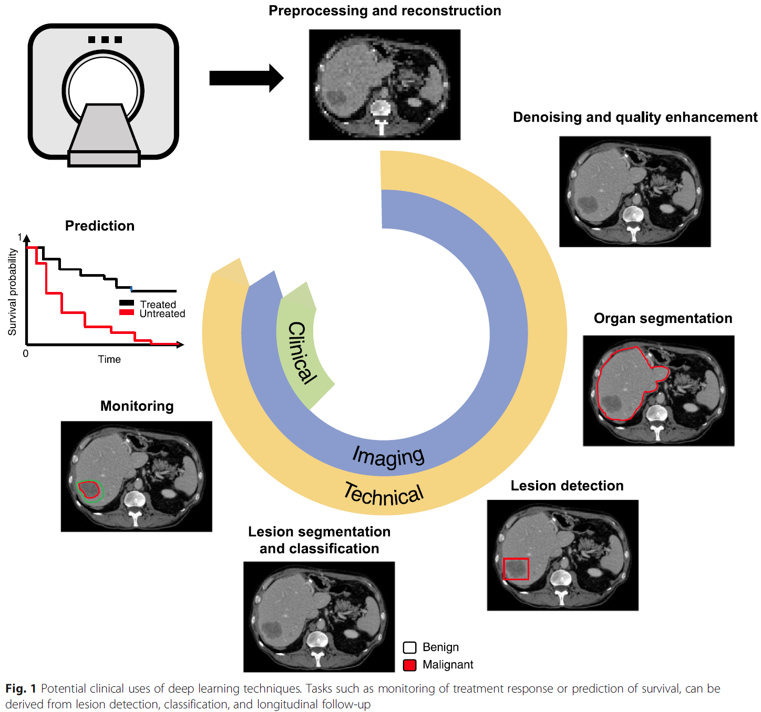
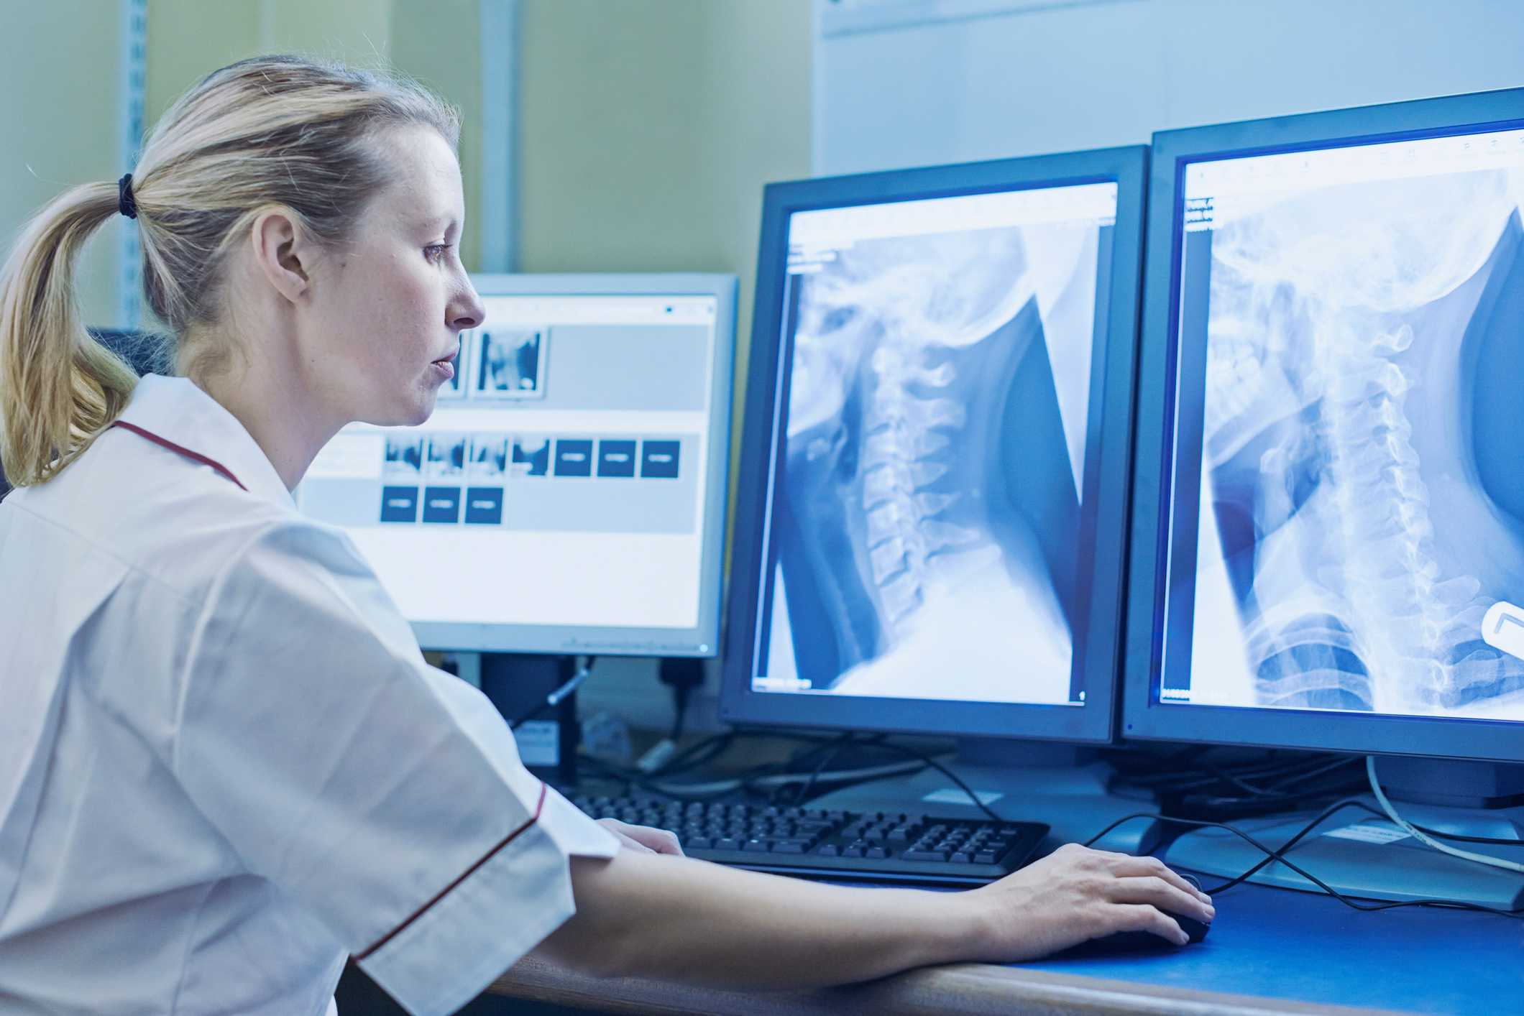
Task-specific Measures
Montagnon, E., Cerny, M., Cadrin-Chênevert, A. et al. Deep learning workflow in radiology: a primer. Insights Imaging 11, 22 (2020). https://doi.org/10.1186/s13244-019-0832-5

Slide 22
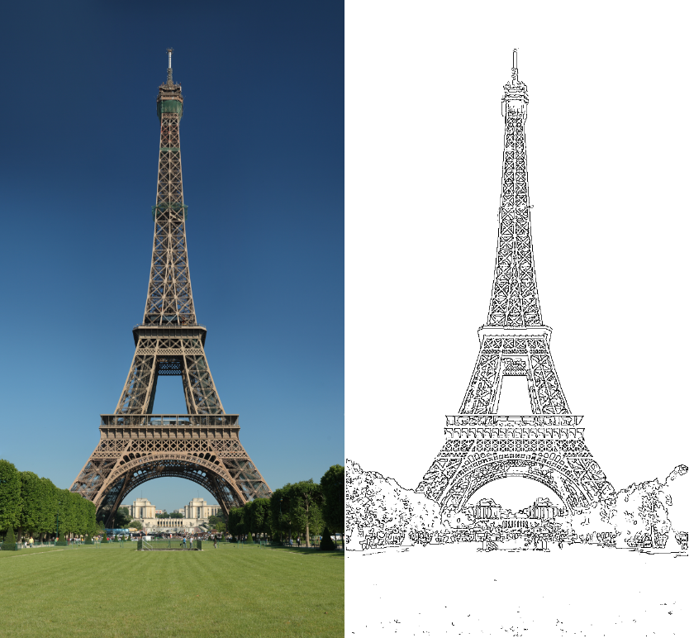
Four Cases (Two Error Types)
Detection Report
Edge Not
Not Edge
True Positive | False Negative
False Positive | True Negative
Type II Error
Ground Truth
Type I Error

Slide 23
Sensitivity & Specificity
Likelihood of a positive case
Or % of edges we find
How sure we say YES
Sensitivity=TP/(TP+FN)
Likelihood of a negative case
Or % of non-edges we find
How sure we say NOPE
Specificity =TN/(TN+FP)

Slide 24
Receiver Operating Characteristic
Sensitivity
Report sensitivity & specificity
Give an ROC curve
Average over many data
Any detector on this side can do better by flipping its output
FP Frac=1-Specificity
Specificity =TN/(TN+FP)

Slide 25
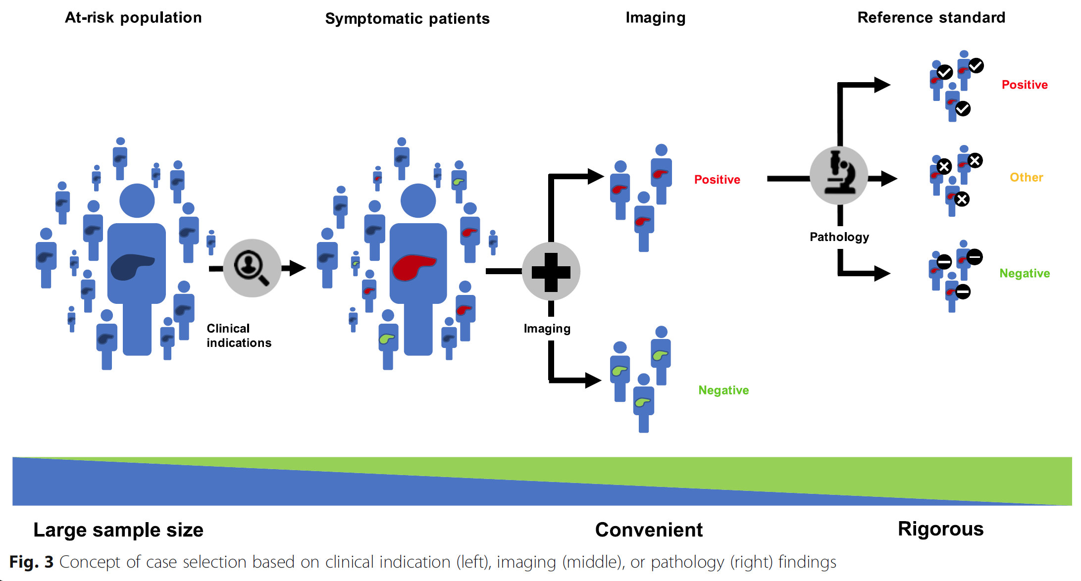
Big Data
Montagnon, E., Cerny, M., Cadrin-Chênevert, A. et al. Deep learning workflow in radiology: a primer. Insights Imaging 11, 22 (2020). https://doi.org/10.1186/s13244-019-0832-5

Slide 26
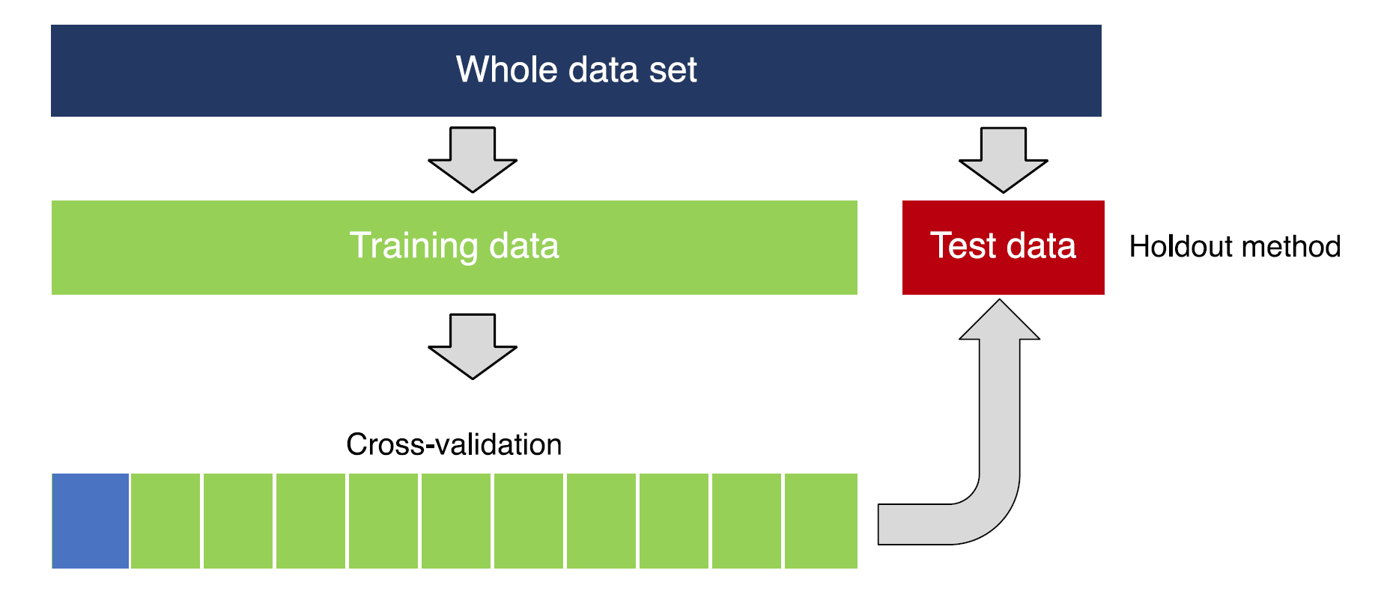

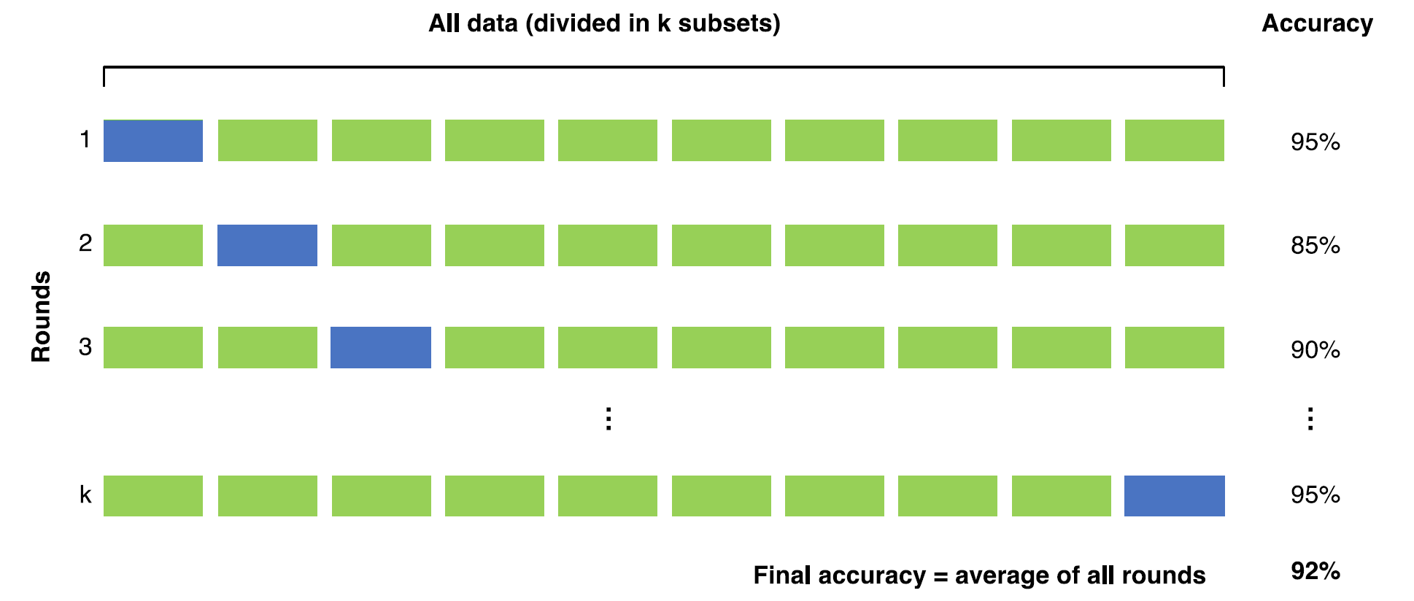
Training, Validation, & Testing
Montagnon, E., Cerny, M., Cadrin-Chênevert, A. et al. Deep learning workflow in radiology: a primer. Insights Imaging 11, 22 (2020). https://doi.org/10.1186/s13244-019-0832-5

Slide 27
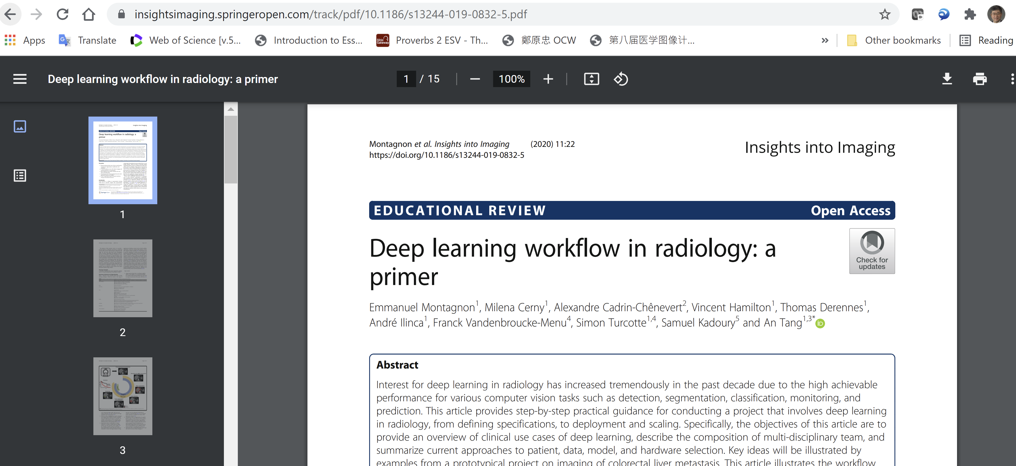

Slide 28
Outline
Momentum of Deep Imaging / AI in Medicine
AI Software as Devices & FDA Approval
Traditional Metrics
GRACE Challenges
Generalizability
Robustness
Autonomy
Certifiability
Explainability

Slide 29
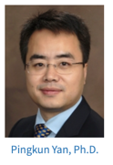
PURGE: Major AI Challenges
Privacy
Uncertainty
Robustness
Generalizability
Explainability
AI-based X-ray Imaging System (AXIS) Lab
Deep Imaging Analytics Lab
Addressing Limitations of Deep Medical Imaging

Slide 30
Generalizability
Robustness
Explainability

Slide 31
Generalizability Issue
FDA approved 130+ medical AI devices,
~50% over last year

Slide 32
ChestXpert – “SHC” by Stanford U
224,316 chest radiographs labeled for 14 common chest observations at Stanford Health Care
Collected from 2002 to 2017
439GB (Downloadable after Registration)
https://stanfordmlgroup.github.io/competitions/chexpert/

Slide 33
MIMIC-CXR – “BIDMC” by MIT
227,835 studies for 64,588 patients at Beth Israel Deaconess Med. Center
377,110 images collected from 2011 to 2016
4.7TB (Available after registration & training)
https://mimic-cxr.mit.edu/

Slide 34
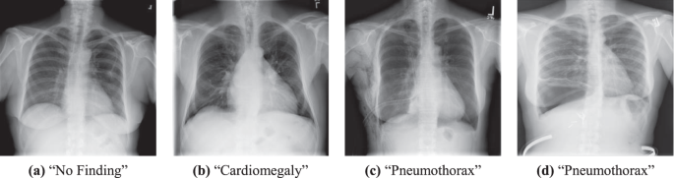
ChestX-ray8 – “NIH” by NIH
108,948 frontal view X-ray images with eight disease labels
Collected from 1992 to 2015
45.7GB (Freely downloadable)
https://nihcc.app.box.com/v/ChestXray-NIHCC

Slide 35
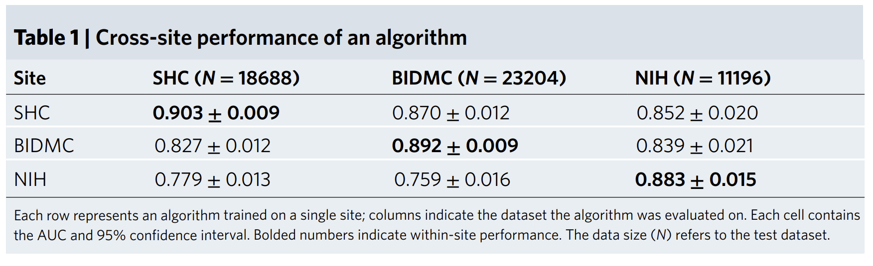
Key Results
They performed a case study on the risk the AI model analyzing chest X-rays for signs of collapsed lungs
The algorithms were ~10% less accurate at other sites
Accuracy was higher on BIDMC for White than Black

Slide 36
Recommendation
“Evaluating the performance of AI devices in multiple clinical sites is important for ensuring that the algorithms perform well across representative populations. Encouraging prospective studies with comparison to standard of care reduces the risk of harmful overfitting and more accurately captures true clinical outcomes. Post-market surveillance of AI devices is also needed for understanding and measurement of unintended outcomes and biases that are not detected in prospective, multi-center trials.”

Slide 37
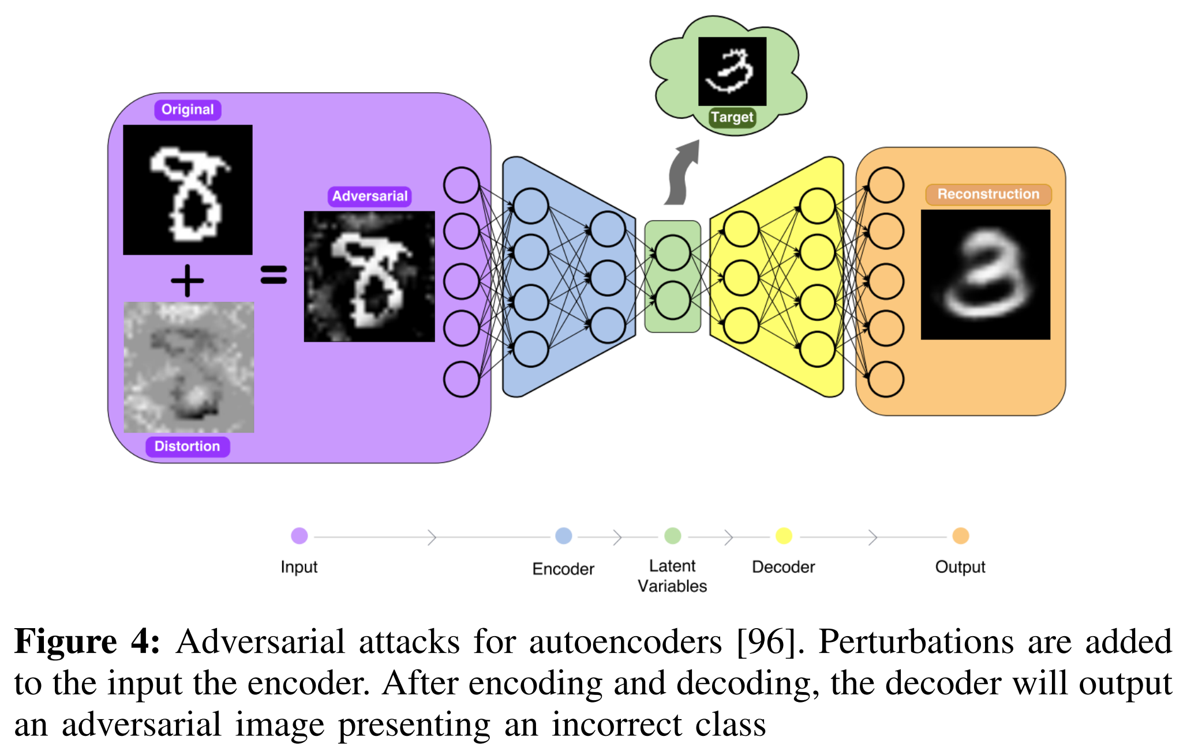
Robustness Issue
https://arxiv.org/pdf/1712.07107.pdf

Slide 38
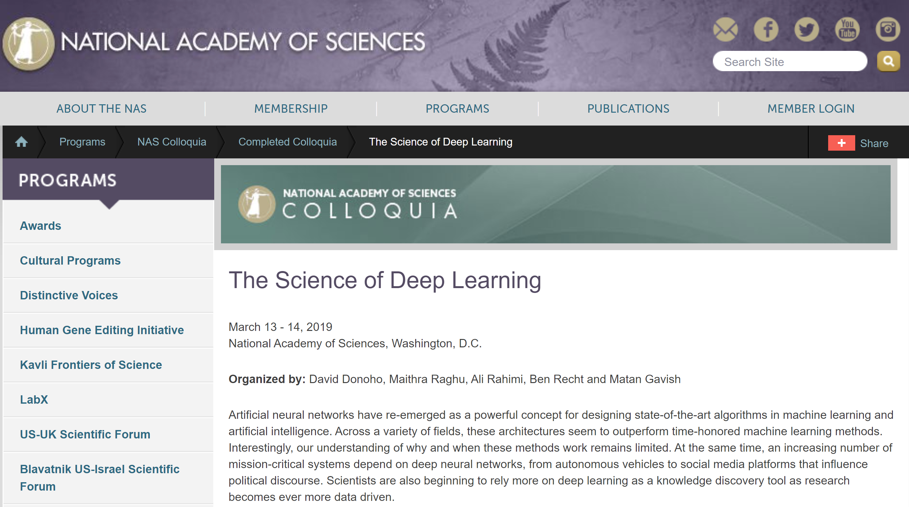
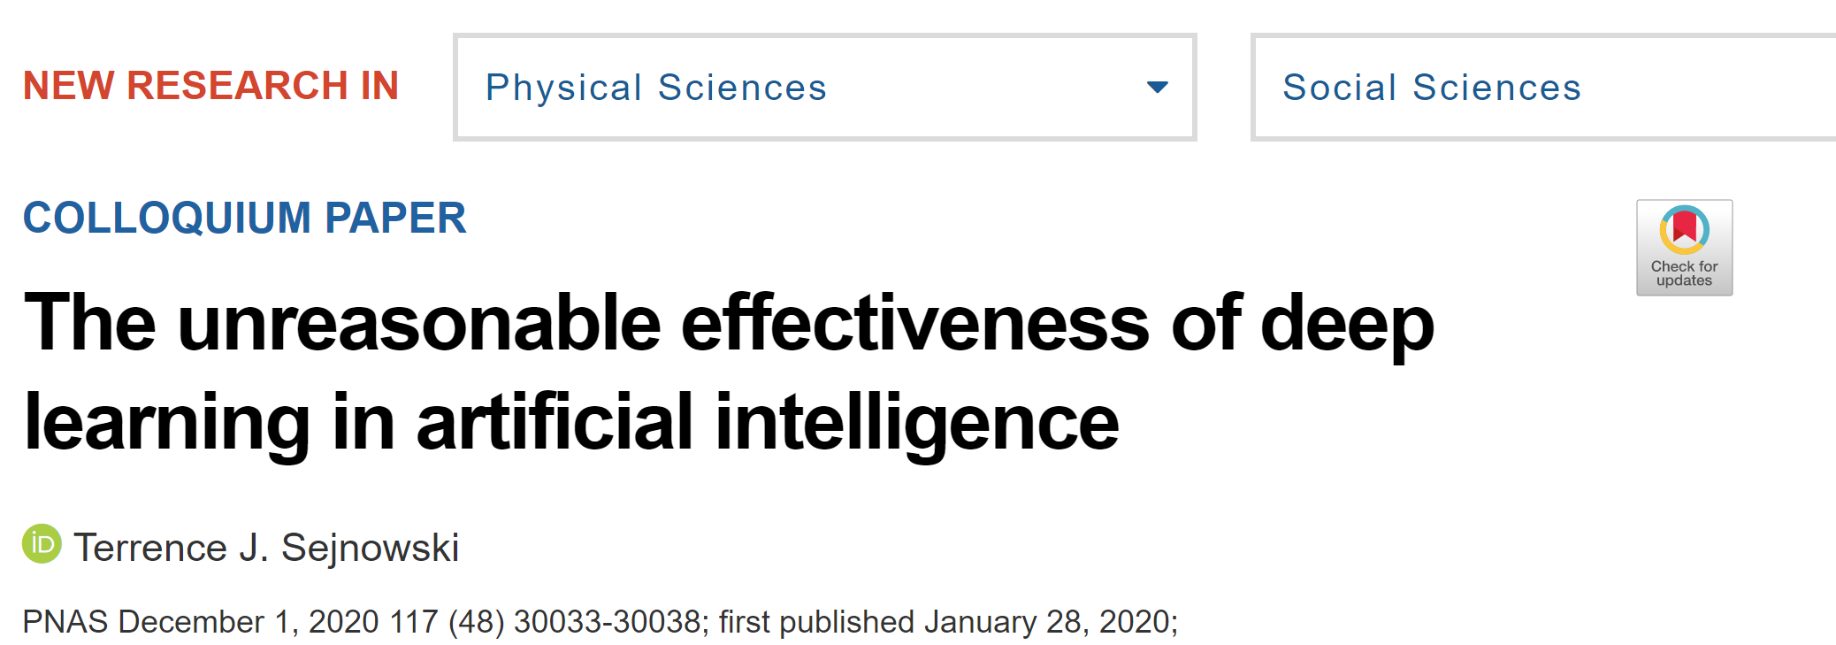

Slide 39
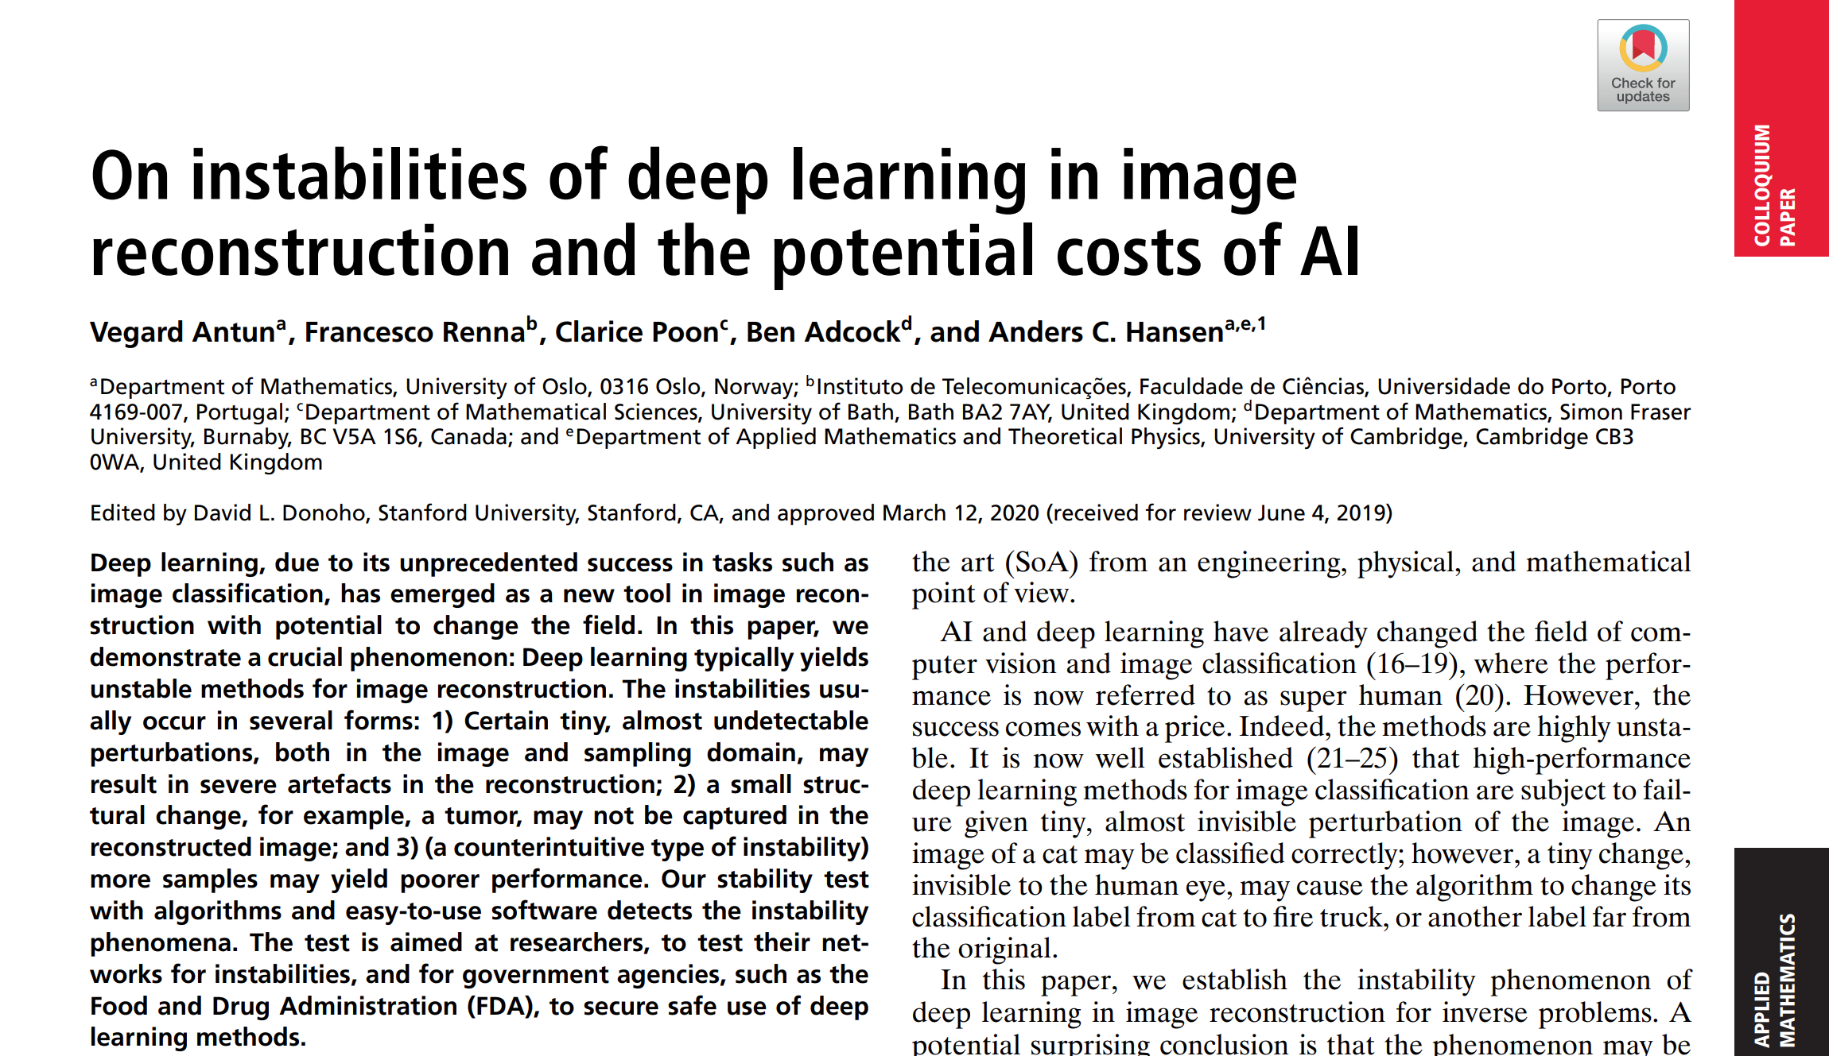
Instabilities of Deep Reconstruction

Slide 40
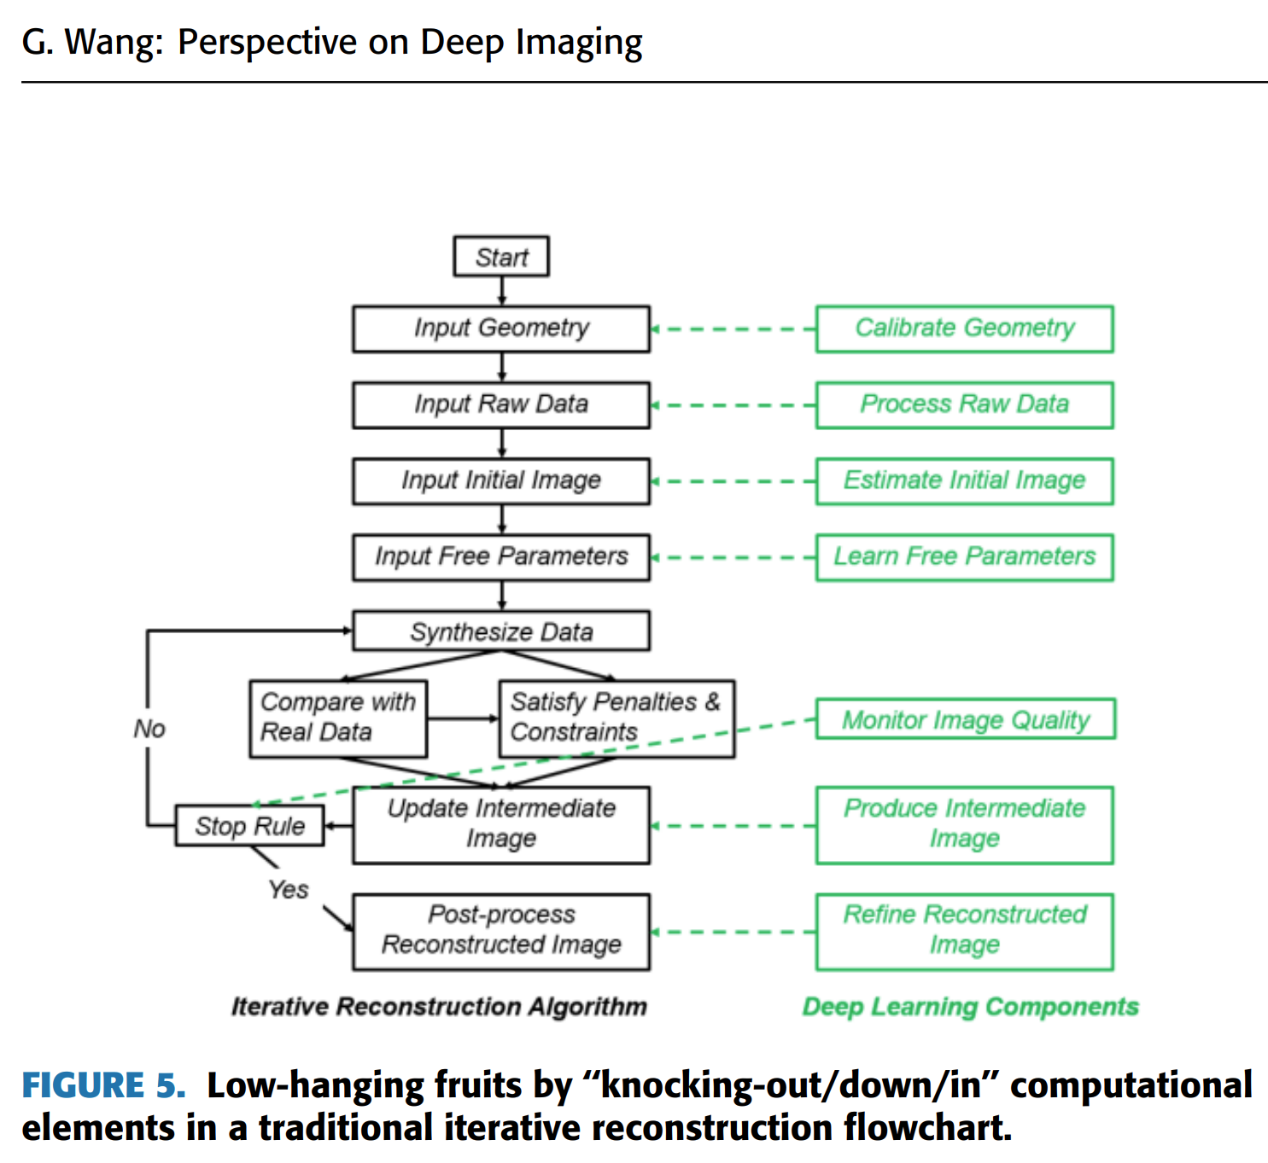
General Answer: Superiority Principle
Classic
Result
Neural Network
Superior Image Quality
Neural Network
Neural Network
Classic
Algorithm
Neural Network
Big Data

Slide 41
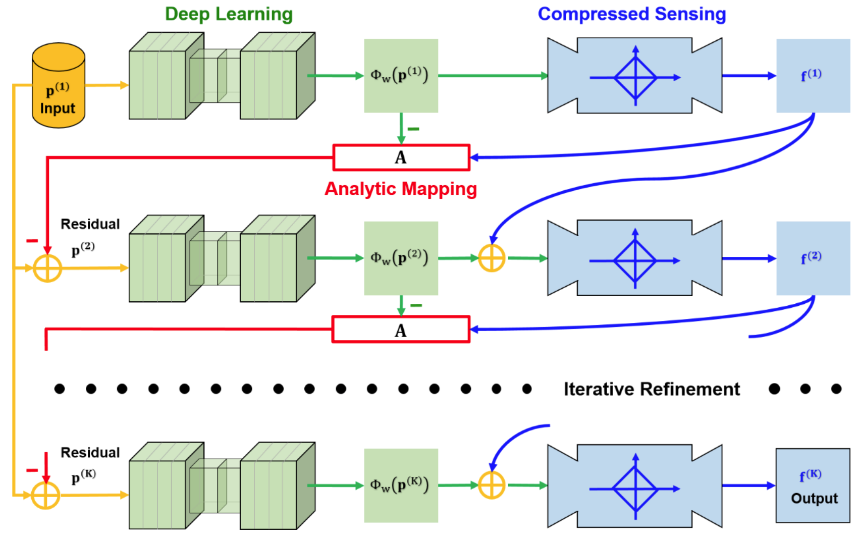
Specific Answer: ACID
Analytic, Compressive, Iterative Deep Network

Slide 42
Best Solution in the Intersection
Data Prior
Sparsity
Data Fidelity
Best Solution
Synergization for Stabilization:
Analytic Compressive Iterative Deep (ACID) Framework
Wu WW, Hu DL, Cong WX, Shan HM, Wang SY, Chuang N, Yan PK, Yu HY, Vardhanabhuti V, Wang G: Stabilizing Deep Tomographic Reconstruction Networks. https://arxiv.org/abs/2008.01846, v1, v2, 2020; v3, v4, 2021

Slide 43
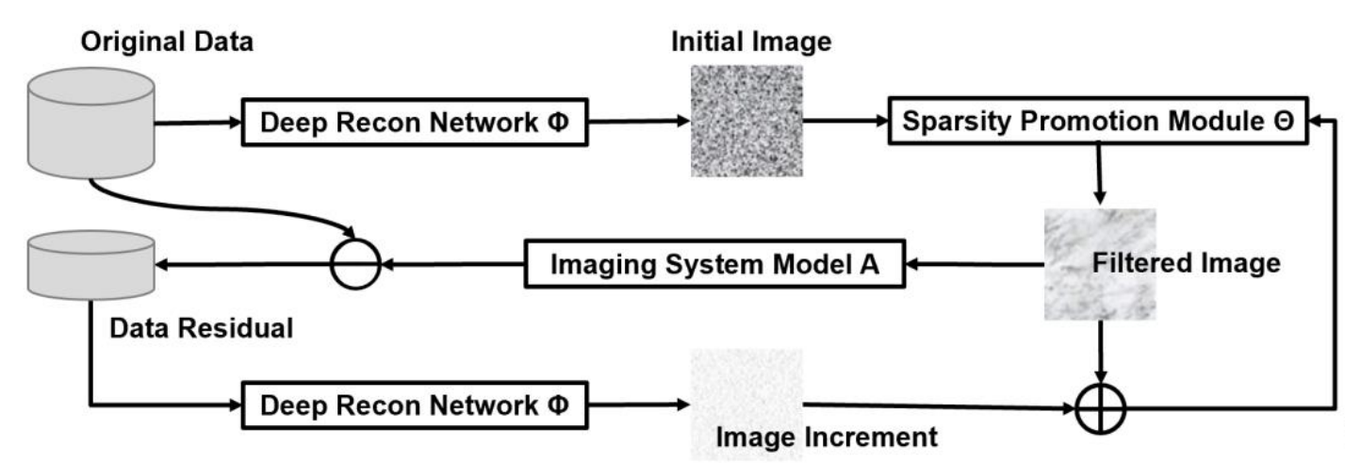
Illustration of Reconstruction Workflow

Slide 44
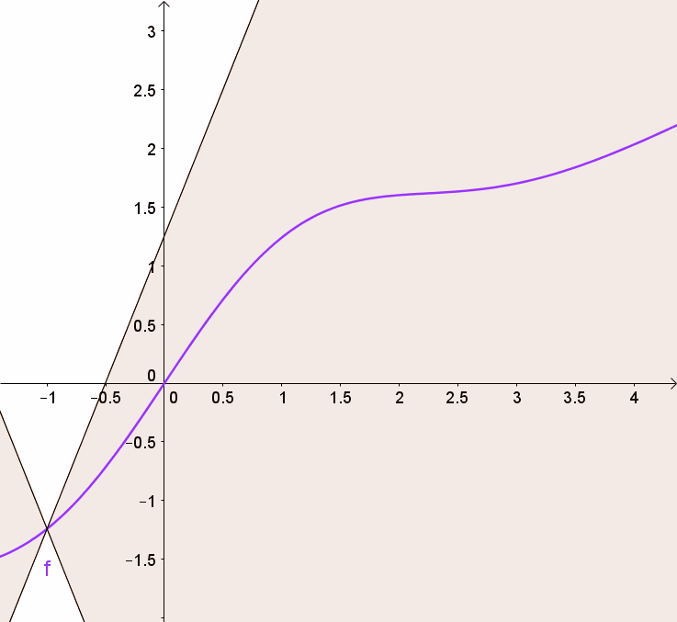
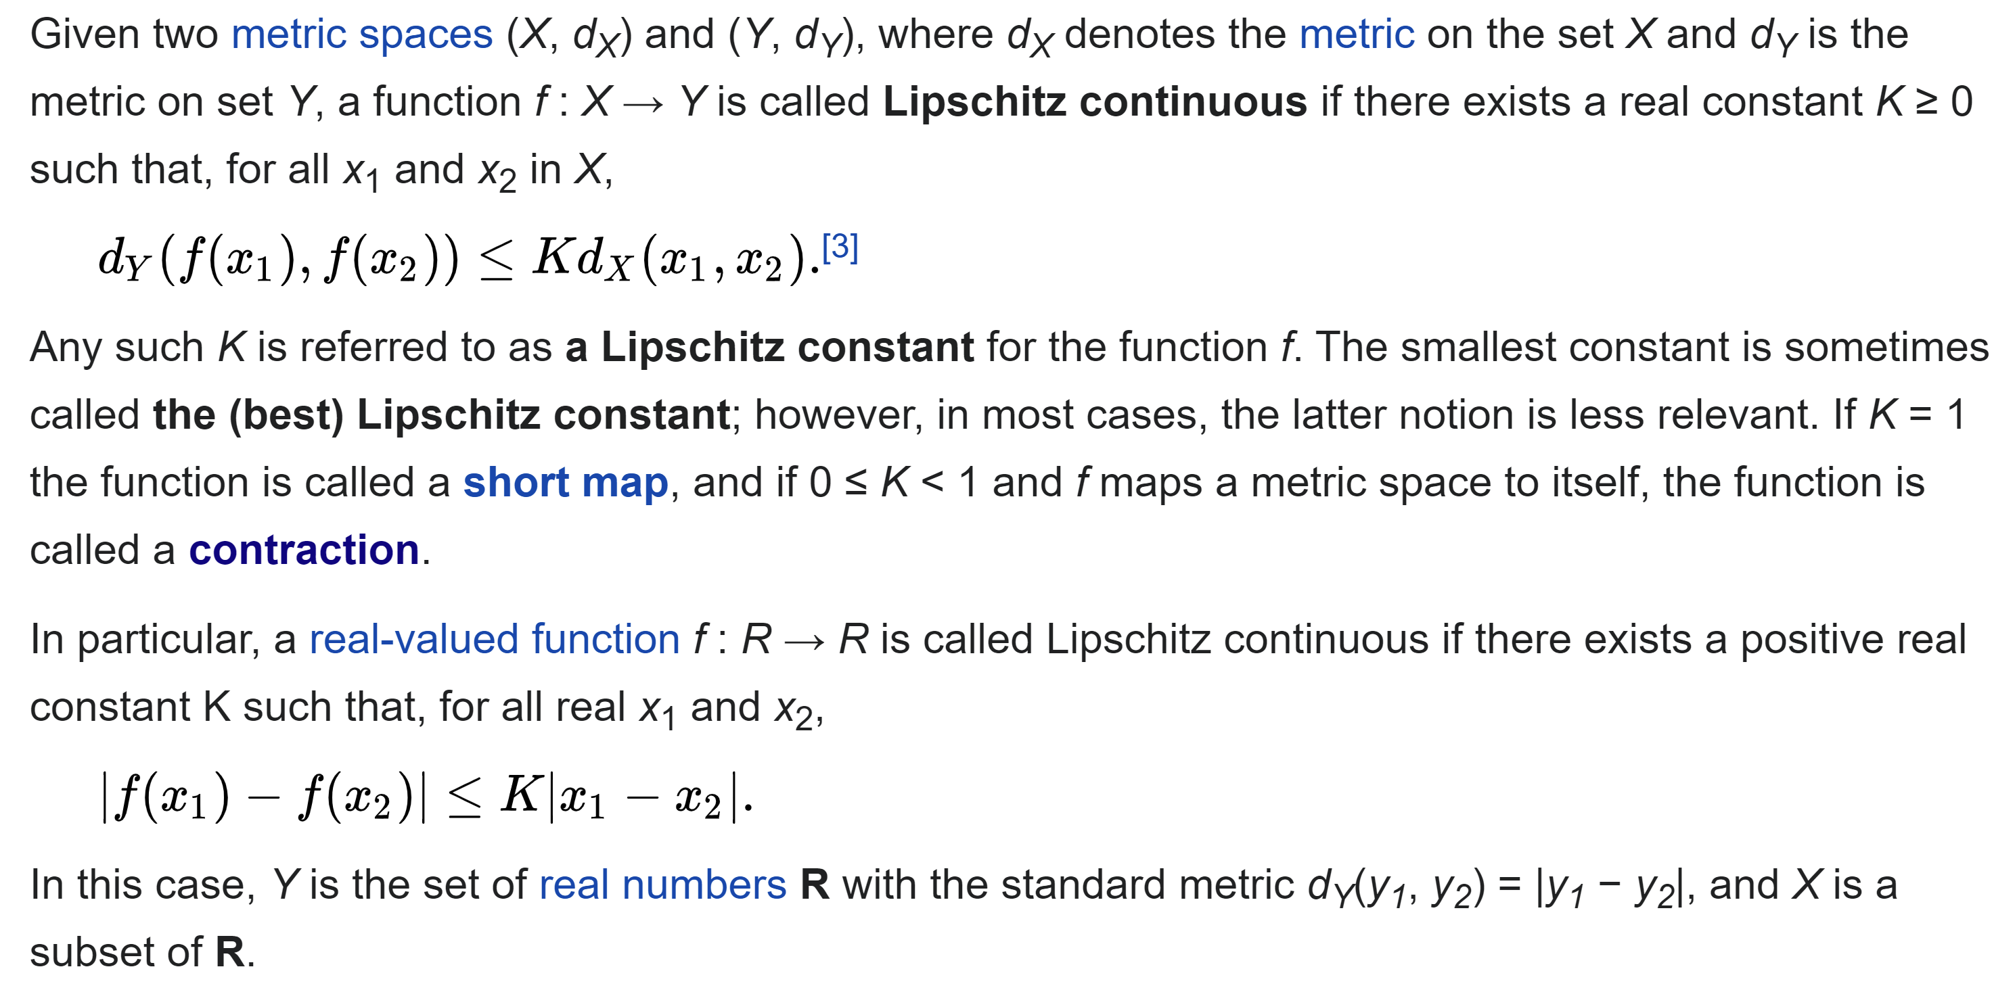

Lipschitz Continuity

Slide 45
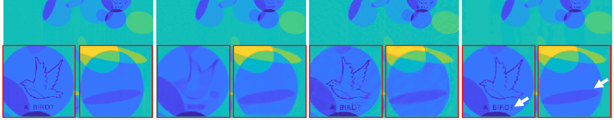
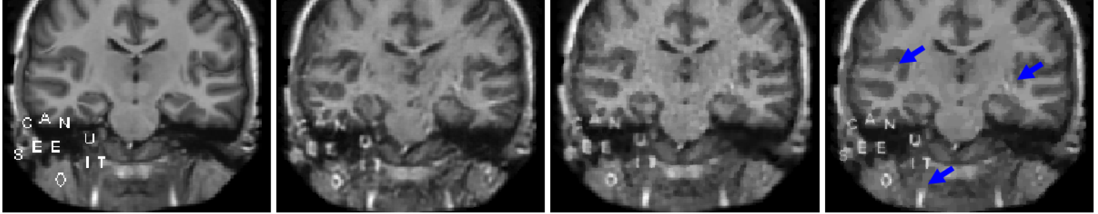
Type I Instability – New Artifacts Generated / Type I Error / False Positive
Type II Instability – Small Features Undetected / Type II Error / False Negative
Ground Truth
Ell-50
CS
ACID
ACID
Ground Truth
DAGAN,
CS
Wu WW, Hu DL, Cong WX, Shan HM, Wang SY, Chuang N, Yan PK, Yu HY, Vardhanabhuti V, Wang G: Stabilizing Deep Tomographic Reconstruction Networks. https://arxiv.org/abs/2008.01846, v1, v2, 2020; v3, v4, 2021

Slide 46

Explainability Issue
F. -L. Fan, J. Xiong, M. Li and G. Wang, "On Interpretability of Artificial Neural Networks: A Survey," in IEEE Transactions on Radiation and Plasma Medical Sciences, doi: 10.1109/TRPMS.2021.3066428, 2021

Slide 47

Interest in Interpretability
F. -L. Fan, J. Xiong, M. Li and G. Wang, "On Interpretability of Artificial Neural Networks: A Survey," IEEE Transactions on Radiation and Plasma Medical Sciences, doi: 10.1109/TRPMS.2021.3066428, 2021
Notes:
There is one interesting point for the curves containing deep learning. You can see that the number of articles is zero until recent years. This is probably because deep learning is a newly coined concept.

Slide 48



Image Inverting
$$\underset{x}{arg min}{{|\left|Ω\left(x\right)−Ω_{0}\right||}^{2}+λR(x),}$$
where $R(x)$ is a regularization term, $Ω(⋅)$ is the network,
and $Ω_{0}$ is the output.
know what information is lost by the model.
A. Mahendran, A. Vedaldi: Understanding deep image representations by inverting them. In CVPR, 5188-5196, 2015.
Notes:
1. There is the information loss when a neural network processes an image. The inverting-based method is to construct an image that can copy the features of the original image.

Slide 49


Activation Maximization
“Deep Dream”
$$Input=Input+\frac{∂Loss}{∂Input}$$
Generate an input image that maximizes filter output activations
Activation maximization applied on MNIST
A. Nguyen, A. Dosovitskiy, J. Yosinski, T. Brox, J. Clune: Synthesizing the preferred inputs for neurons in neural networks via deep generator networks. In NeurIPS 3395-3403, 2016.

Slide 50


Important Data Path
Q: What is the important data routing path in a network?
$$\underset{λ_{1}, …,λ_{K}}{arg min}{d\left(f_{θ}\left(x\right),f_{θ}\left(x;λ_{1}, …,λ_{K}\right)\right)+γ\sum_{k}{|{\left|λ_{k}\right||}_{1}},}$$
Important node
Negligible node
Block some neurons in every layer and check network performance
Identify the important data routing path in a network.
Y. Wang, H. Su, B. Zhang, X. Hu: Interpret neural networks by identifying critical data routing paths, In CVPR, 8906-8914, 2018

Slide 51


Neuron Dissection
Compute the receptive field of a neuron
interpret the role of a neuron
D. Bau, et al. Understanding the role of individual units in a deep neural network.
Proceedings of the National Academy of Sciences, 117:30071-8, 2020.

Slide 52



Influence Function
Q: How will the model’s prediction change without a given training point?
Removing it reduces the loss
Efficient approximation
Identify which in the dataset is harmful for the prediction of a test image
Koh PW, Liang P: Understanding black-box predictions via influence functions.
Proceedings of International Conference on Machine Learning, 1885-1894, 2017

Slide 53

Class Activation Map
Zhou BL, Khosla A, Lapedriza A, Oliva A, Torralba A: Learning Deep Features for Discriminative Localization. https://arxiv.org/abs/1512.04150, 2015

Slide 54

Knowledge Distillation
Train a student model from a teacher network
G. Hinton, O. Vinyals, J. Dean: Distilling the knowledge in a neural network. arXiv:1503.02531, 2015

Slide 55


Counterfactual Case
Q: What is “closest possible case” to yield a different outcome?
$$\underset{{ x}^{′}}{\arg{min}}{λ{\left(f\left(x^{′}\right)−y^{′}\right)}^{2}+d(x,x′)}$$
$y^{′}$ is a different label, and $d(⋅,⋅)$ is a distance
S. Wachter, B. Mittelstadt, C. Russell: Counterfactual explanations without opening the black box: Automated decisions and the GDPR. Harv. JL & Tech., 31:841, 2017

Slide 56
Homework
Explain the interpretability, generalizability, and robustness of deep networks in your own words and with examples (review this PPT file and search on Google if needed)

Slide 57


Homework (Find AUC for Modified Data)
₊₂
₊₂
₊₂
₊₂
₊₂
₊₂
₊₂
₊₂
₊₂
₊₂

Slide 58


